Slide 1


Institute of Technology of Cambodia
Master of Data Science
IT Project Management
Human Resource Management at PayPal
Instructed by: M. CHAN Sophal
Present by:
LENG SENG HAK M080102

Slide 2

Background of PayPal
Established: December 1998
Founders: Peter Thiel and Luke Nosek
First Business: Developed Security Software
Current Business: Online Payment Platform

Slide 3
1. PayPal Mindset and Value
Mindset at PayPal
Better to take bold risk than triviality
A bad plan is better than has no plan
Sales is as much important as the product
Competitiveness market destroy profits
Employee’s value
Inclusion
Innovative
Collaboration
Wellness

Slide 4
2. PayPal Work Culture
The working culture at PayPal are:
You can come and leave as long as you complete the tasks
Relaxed, fun, flexible timings, Friday happy hours(sometime), team lunches, launch parties etc.
If you perform well and solve hard problems you will be rewarded.
Play hard, work hard.
Very diverse people
People can work from home.
Fun company events.

Slide 5
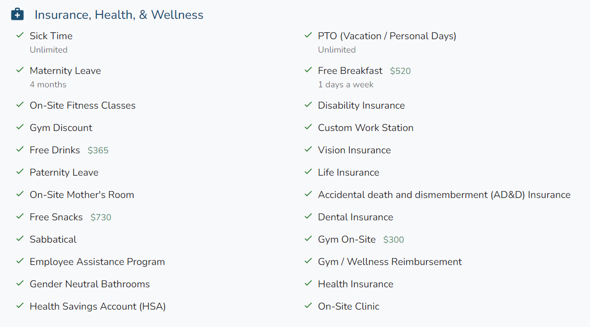
3. Employee’s Benefits
The perks for employee’s working at PayPal are:

Slide 6
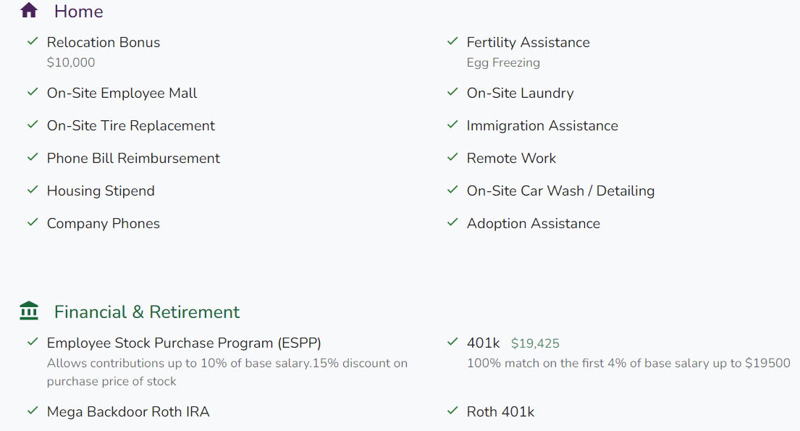
3. Employee’s Benefits

Slide 7
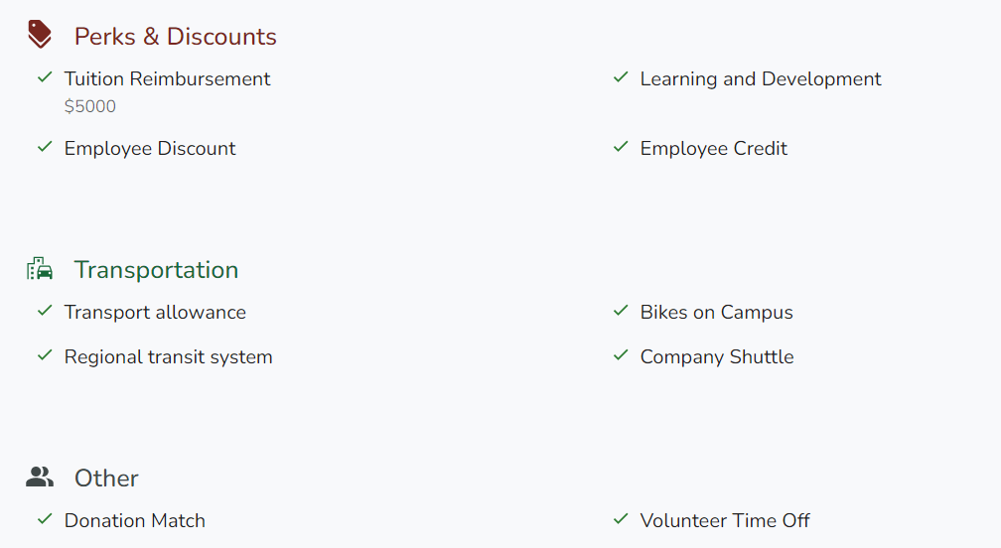
3. Employee’s Benefits

Slide 8
4. Employee’s Work Review
Employee: Nirwa Mehta (Data Analyst)
Summary:
Amazing journey with a lot of learning and growth potential
Excellent salary, expect a hike half-yearly or annually
You can create your own opportunities to grow, build relationships
Company even conducts fortnightly meditation classes and courses for stress and anger management
Professionally you will grow, and find a good learning environment, good food, free drinks, chocolate, medical facilities, transportation, play stations, after-hours parties, outings
Source: https://qr.ae/pr4fKk

Slide 9
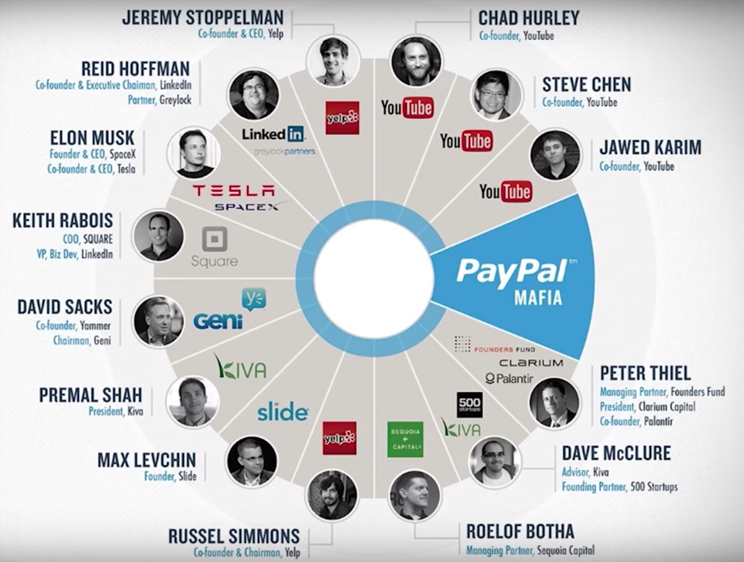
5. PayPal Mafia

Slide 10
Thank you for your Attention!!!
Any Question!?

